Slide 1
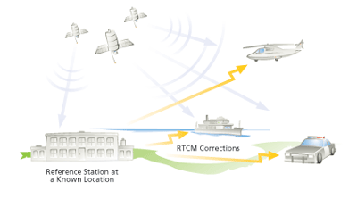
Differential GPS & Carrier Phase Positioning
ASEN 5090
http://www.esri.com/news/arcuser/0103/differential1of2.html
ASEN 5090 LECTURE NOTES – LARSON, AXELRAD

Slide 2
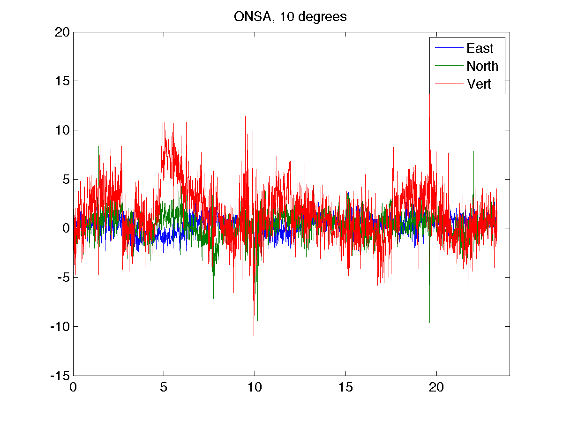
meters
hours

Slide 3
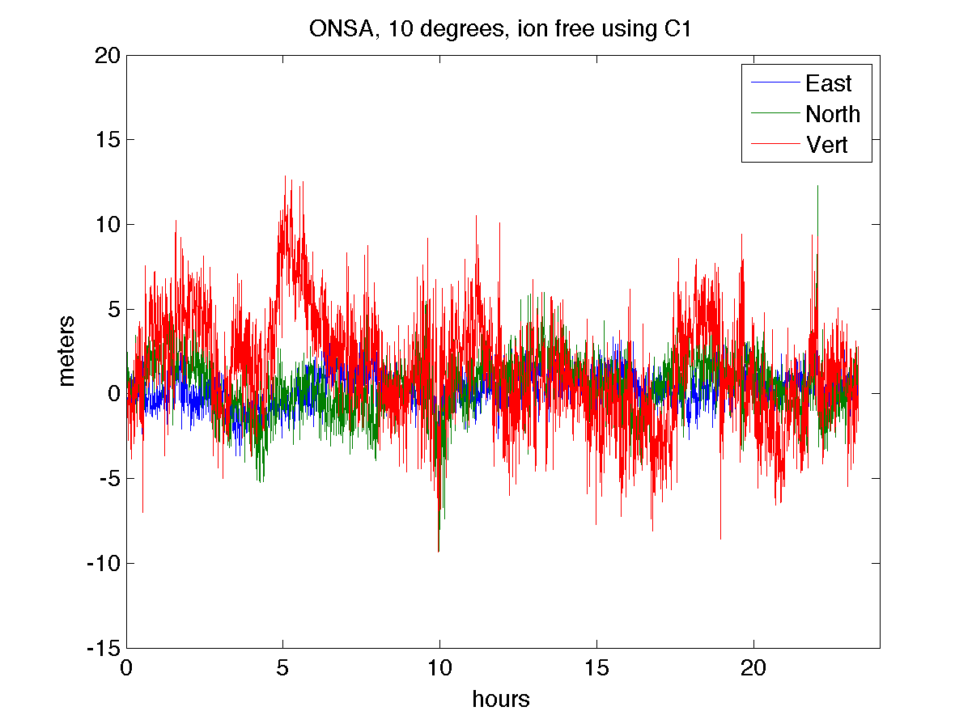

Slide 4
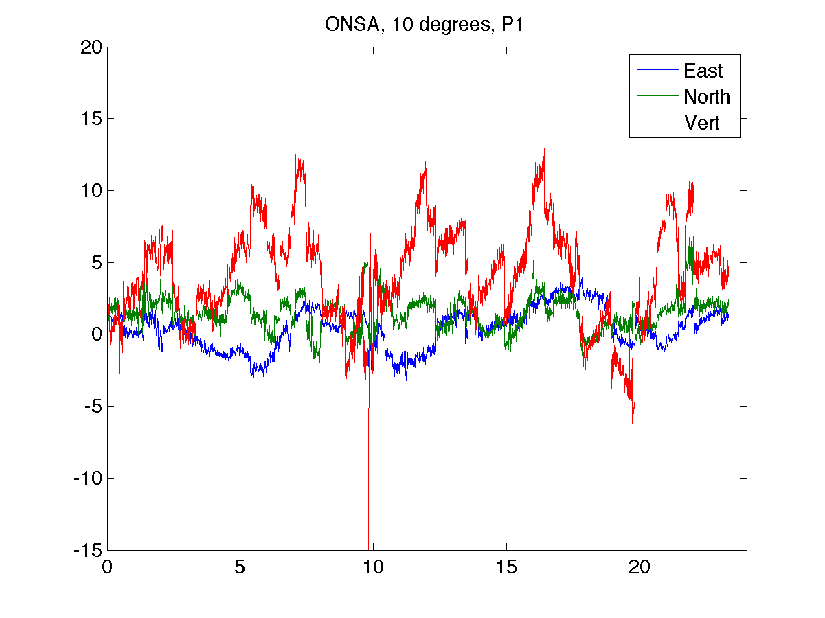
meters
hours

Slide 5
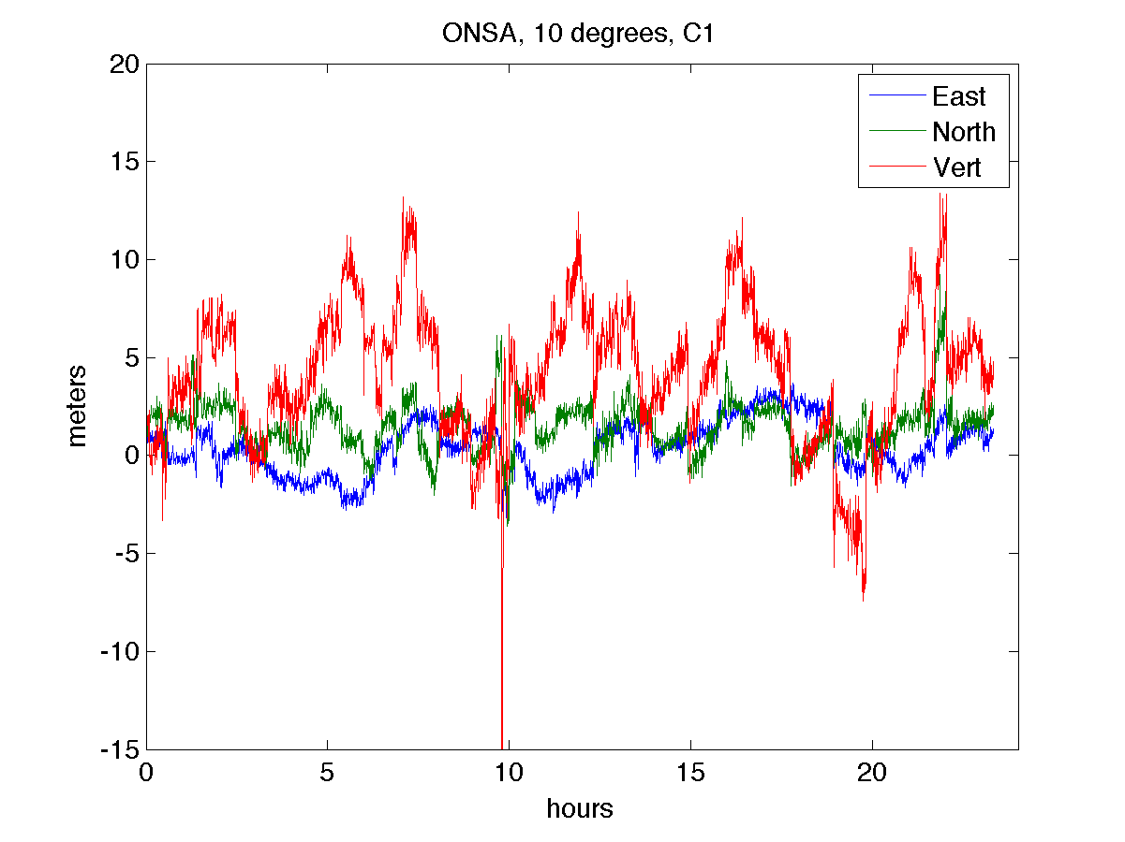

Slide 6
Outline
GPS Point Positioning
Local Area DGPS
Wide Area DGPS
Carrier phase positioning RTK (real-time kinematic)

Slide 7
Positioning Techniques
1. Standalone Pseudorange (aka Navigation Solutions)
Homework 8
Typical dual frequency accuracy of several m
2. Precise Pseudorange positions
Use precise orbits and clock corrections (not a heck of a lot better than 1.)
3. DGPS (differential GPS)
Corrections for common mode errors between user and reference station sent via communication link
Typical accuracy of ~1-3 m
Real time
4. Carrier phase positioning (can be differential)
Centimeter level accuracy
Requires integer ambiguity resolution
Increased accuracy, more complexity

Slide 8
Local Area Differential GPS
Errors common to two receivers can be cancelled by sharing information
Satellite clock
Orbit
Ionosphere
Troposphere
Cannot cancel multipath, receiver noise
Requires reference station with known location
Stable clock (predictable behavior)
Good satellite visibility
Low multipath
Communication link to users
Also referred to as GBAS (Ground Based Augmentation System, I think)

Slide 9
Differential GPS
Pseudorange observables
At reference station, compute correction
Apply at user
Assumes iono, tropo are identical at reference and user receiver
In reality, iono decorrelation is ~1m/100km, tropo depends on height and weather
Smaller the ref-user separation and more frequent corrections yield better accuracy

Slide 10
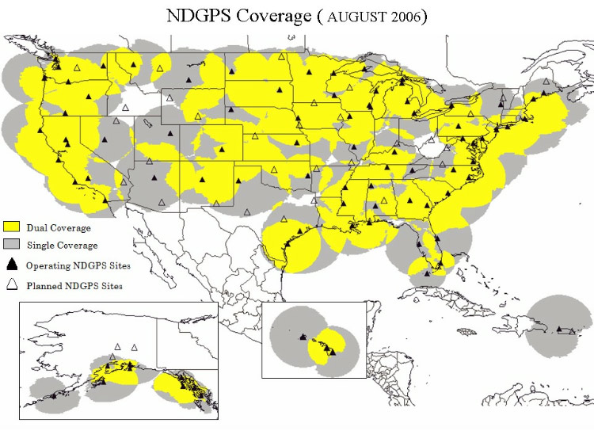
NDGPS System
Nationwide DGPS system operated by Coast Guard
System overview
Corrections transmitted in 285-325 KHz band at 100-200 bps
Latency on order of 2-5 sec
~400 km range
Guarantees 10 m horizontal accuracy in all coverage areas
Actual accuracy often on meter level
Also broadcasts integrity messages

Slide 11
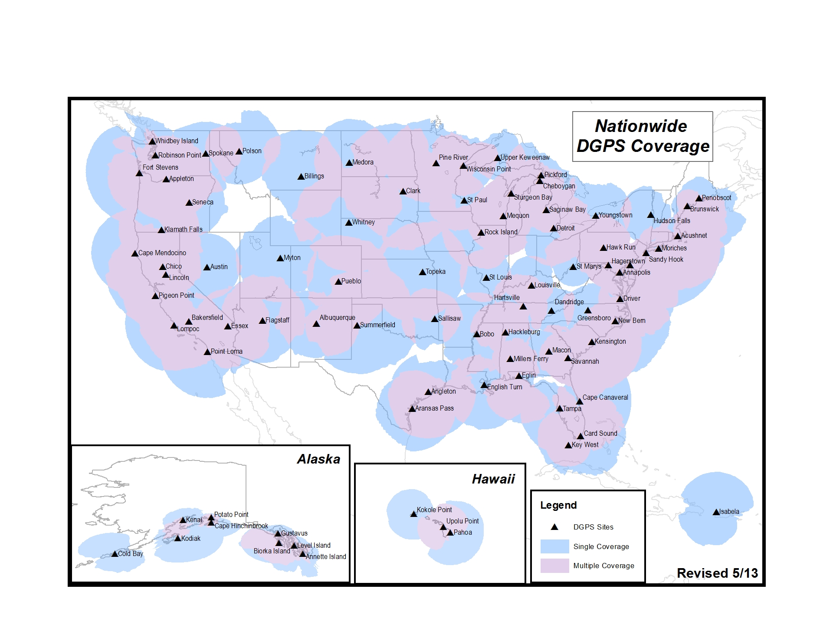
NDGPS System

Slide 12
meters
hours

Slide 13
From their website: Why use DGPS? DGPS accuracy and integrity are better than GPS. * Accuracy improvement (2drms): Positions of 10 meters or better are achievable using DGPS (USCG signals) vs. 100 meters or better for GPS (Standard Positioning Service) * Integrity improvement: Provides an independent check of each GPS satellite's signal, and reports whether it's good or bad.

Slide 14
Aircraft Landing
Satellite Clock / Orbit
Satellite
Ionosphere
~50-1000km
~20,000km
~20,000km
Troposphere
~0-12km
Multipath
Aircraft
Differential Corrections
Ground
Reference
Receiver
Airport

Slide 15
Accuracy
Typical standalone errors are too large for some applications
Precision approach and landing, surveying, etc.
One solution – Local Area Differential GPS (LDGPS)
Surveyed reference station provides differential corrections
Effective if reference station is within ~50-100 km
Error Source | RMS Error Size | RMS LDGPS Error Size
Satellite Clock / Orbit | 3 – 4 m | 0.1 m
Ionosphere | 2 – 10 m | 0.1 m
Troposphere | 1 – 3 m | 0.2 m
Multipath | 0 – 5 m | 0 – 5 m
Total Error | 3.7 – 12.3 m | 0.2 – 5 m

Slide 16
WAAS
Using the data from the WRS (reference station) sites, the WMSs (master stations) generate two different sets of corrections: fast and slow.
The fast corrections are for errors which are changing rapidly and primarily concern the GPS satellites' instantaneous positions and clock errors. These corrections are considered user position-independent, which means they can be applied instantly by any receiver inside the WAAS broadcast footprint.
The slow corrections include long-term ephemeris and clock error estimates, as well as ionospheric delay.
While the slow data can be updated every minute if necessary, they are typically only updated every 2 minutes and are considered valid for up to 6 minutes.

Slide 17
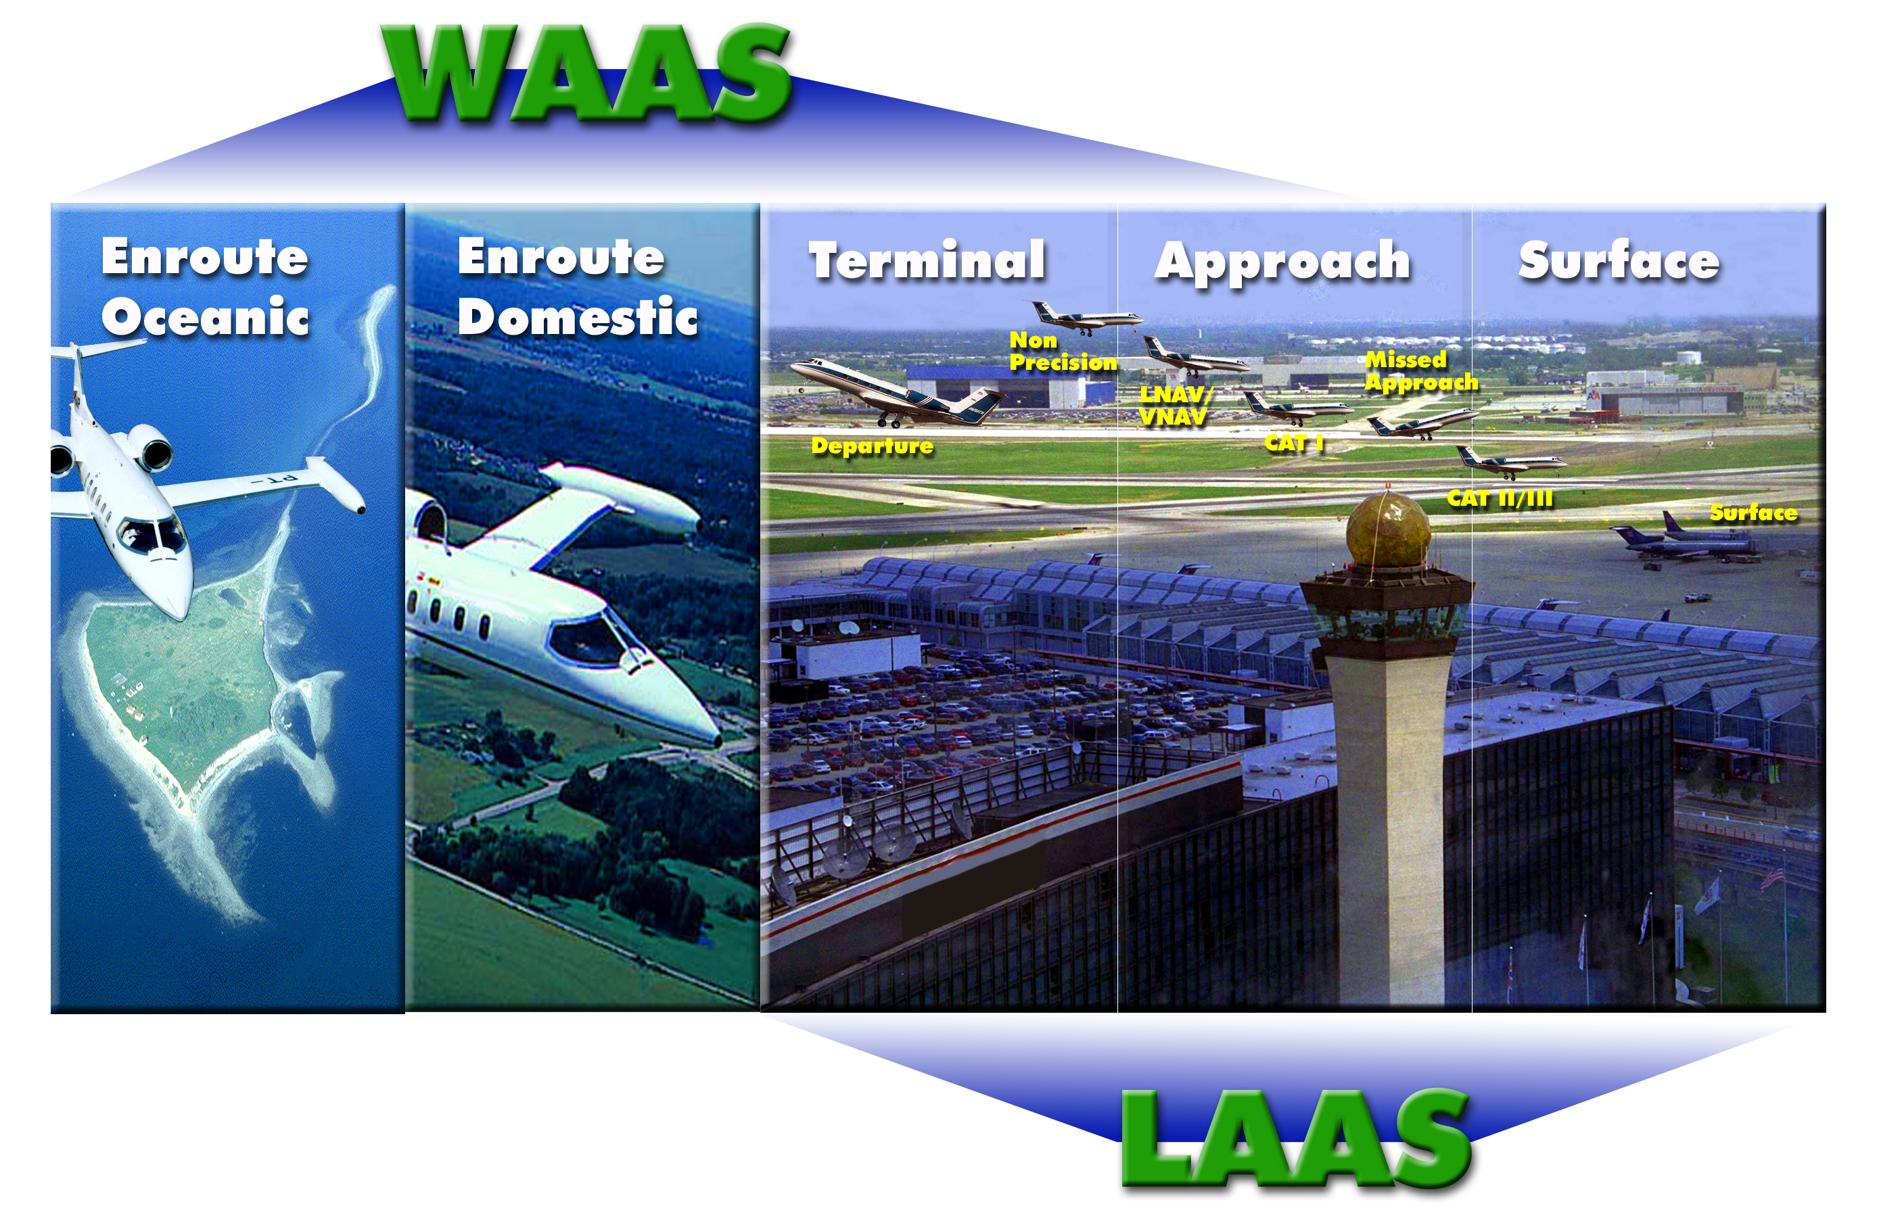
LAAS / JPALS
FAA Local Area Augmentation System (LAAS)
DoD Joint Precision Approach and Landing System (JPALS)
Similar architecture
Differential code corrections and integrity
JPALS differences
P(Y) code, full tracking on L1 / L2, concerns for RFI + Jamming
GPS
JPALS/LAAS

Slide 18
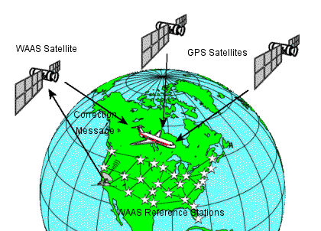
Wide Area DGPS
Reference station measurements collected at master station which computes corrections
Errors are estimated separately such that corrections can be interpolated between reference stations
Corrections typically broadcast via satellite link (SBAS)
FAA WAAS system
25 reference stations across US
Measurements processed by master station and broadcast via geostationary satellites (C/A code like signal with 250 bps data channel)
Transmits both PR corrections and integrity information
Accuracy <= 3 m (95%) according to Garmin

Slide 19
High precision positioning
To improve accuracy and precision of position solutions you need to:
Reduce orbit error contribution to solution
Reduce satellite clock error contribution to solution
Reduce ionospheric and tropospheric errors
Reduce multipath and receiver tracking noise
Carrier phase measurements have much better multipath and tracking noise than pseudorange measurements
Other errors can be reduced by:
Differencing phase measurements from your platform with observations from nearby reference stations
Using “products” developed using global networks of reference stations

Slide 20
“CARRIER PHASE”
When a channel first locks onto the carrier signal it measures the fractional phase between 0 and 1 cycle
As the tracking loop adjusts the carrier replica to stay aligned with the received signal, it accumulates the frequency adjustments made.
The initial phase and the accumulated adjustments give a precise measure of range with an ambiguity that corresponds to the total range when the tracking begins

Slide 21
CARRIER PHASE MODEL
K. Larson and P. Axelrad, University of Colorado

Slide 22
COMPARE PSEUDORANGE and CARRIER PHASE
bias term N does not appear in pseudorange
ionospheric delay is equal magnitude but opposite sign
troposphere, geometric range, clock, and troposphere errors are the same in both
multipath errors are different (phase multipath error much smaller than pseudorange)
noise terms are different (factor of 100 smaller in phase data)
K. Larson and P. Axelrad, University of Colorado

Slide 23
Carrier Phase Measurements
Carrier phase measurements can be measured to 1mm precision with a 1-sigma accuracy of ~5mm
Can only use phase measurements as pseudorange if integer ambiguities are known exactly or are estimated.
Two primary techniques:
Standalone, post-processed solutions - Must have enough data such that geometry varies
Relative positioning, aka Real-time kinematic (RTK)
K. Larson and P. Axelrad, University of Colorado

Slide 24
Double Difference Carrier Phase Observable
Single difference (two sites, one satellite, one freq)
Double difference is the difference of the SD for two satellites (j,k)
K. Larson and P. Axelrad, University of Colorado

Slide 25
Ambiguity resolution
To use carrier phase data you must estimate the N’s
This can be done using combination of pseudorange and carrier phase data with precise orbits and clocks
Double difference integers can be resolved quickly/instantaneously with high-quality dual frequency phase measurements. Many techniques developed for accomplishing this – LAMBDA is one
Key factor is narrowing the search space of possible integer values until only one set is likely
“Float solutions” are also used, in which N’s are estimated as real-valued parameters rather than being fixed to integers.
K. Larson and P. Axelrad, University of Colorado

Slide 26
Real time Kinematic (RTK)
A carrier-phase based positioning technique which solves for a platform position based on its own observations and those from a nearby reference station
A data link is required to transmit/receive the observations
Measurements are synchronized to GPS 1-s epochs
Raw measurements are exchanged
Fixed integer solutions can be reliably obtained for short baselines and dual frequency receivers
K. Larson and P. Axelrad, University of Colorado

Slide 27
PPP – Precise Point Positioning
“PPP is the … solution to the processing of pseudorange and carrier-phase measurements from a single GNSS receiver, utilizing satellite constellation precise orbits and clock offsets determined by separate means.”
“Separate means” – a network of ground stations with high performance receivers, precise models of everything
“Precise orbits and clock offsets” – estimates that are accurate enough to allow for carrier phase ambiguities to be estimated.
All the accuracy of RTK without the hassle – what’s the catch?
http://www.gpsworld.com/gnss-system/algorithms-methods/innovation-precise-point-positioning-7040
http://www.insidegnss.com/auto/NovDec06GNSSSolutions.pdf
K. Larson and P. Axelrad, University of Colorado

Slide 28
Online ppp services
Natural Resources Canada Site
http://webapp.geod.nrcan.gc.ca/geod/account-compte/login.php
JPL Site ( but also might require you sign up?)
http://apps.gdgps.net/
Provide mm to decimeters for static and kinematic positioning.
Online data processing services and real-time and near real-time support
K. Larson and P. Axelrad, University of Colorado

Slide 29
Information from National Resources Canada PPP site
http://www.geod.nrcan.gc.ca/faq_e.php#ppp4
K. Larson and P. Axelrad, University of Colorado

Slide 30
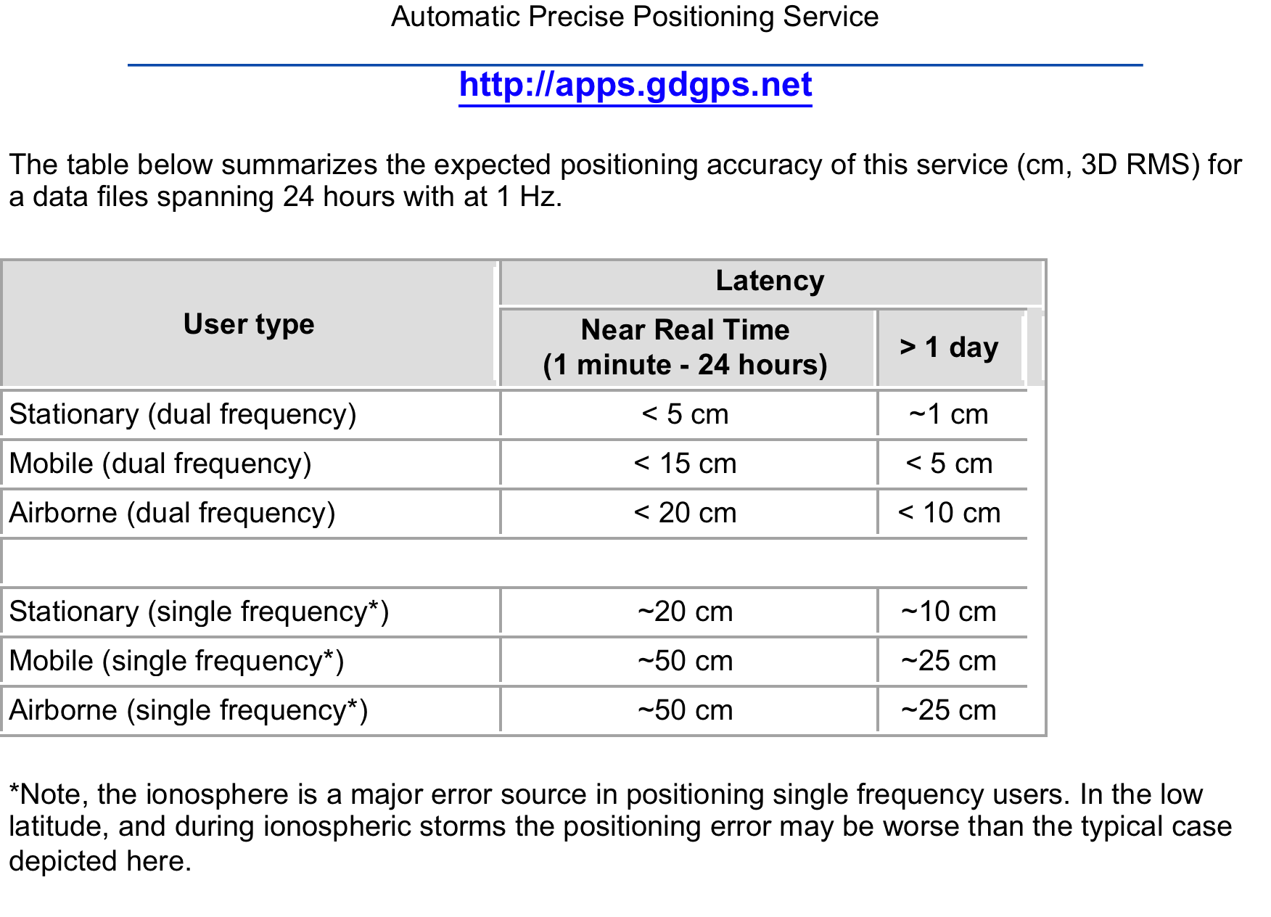
From JPL APPS Site
30
K. Larson and P. Axelrad, University of Colorado

Slide 31
Purpose of GPS/GNSS networks
Provide and archive data
E.g., 10+ years of data regularly available.
Set standards
Site requirements, format, etc.
Coordinate analysis efforts
In making products out of the raw observations…
Support scientific activities
ITRF, orbits, etc.
Earthquakes, landslides, weather & climate, etc.
31
Courtesy F. Nievinski, University of Colorado
31

Slide 32
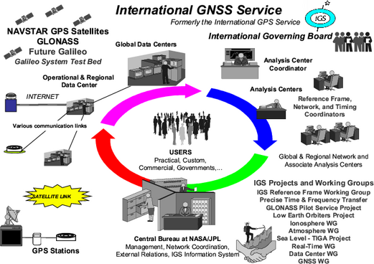
International GNSS Service (IGS)
http://igs.org/
Federation of 200+ worldwide agencies, universities, research institutions.
Tracking network
Products
Community
Courtesy F. Nievinski, University of Colorado

Slide 33
International GNSS Service (IGS)
They do orbits, so you don’t have to.
Courtesy F. Nievinski, University of Colorado

Slide 34
IGS Products
In addition to raw (RINEX) observations…
Various orbit products
Station positions (mm-level)
Clocks
Earth rotation parameters
Polar motion, UT1-UTC, etc.
Atmospheric parameters (troposphere, iono)
Courtesy F. Nievinski, University of Colorado
34

Slide 35
IGS Community
Analysis centers: process observations to make products
Data centers: archive and provide access to obs. & prod.
Working groups: specialized topics
Reference frame, clocks, real-time data, atmosphere, etc.
Center for Orbit Determination in Europe, AIUB, Switzerland | CODE
European Space Operations Center, ESA, Germany | ESOC
GeoForschungsZentrum, Germany | GFZ
Jet Propulsion Laboratory, USA | JPL
National Oceanic and Atmospheric Administration / NGS, USA | NOAA
Natural Resources Canada, Canada | NRCan
Scripps Institution of Oceanography, USA | SIO
U.S. Naval Observatory, USA | USNO
Massachusetts Institute of Technology, USA | MIT
Geodetic Observatory Pecny, Czech Republic | GOP-RIGTC
Courtesy F. Nievinski, University of Colorado

Slide 36
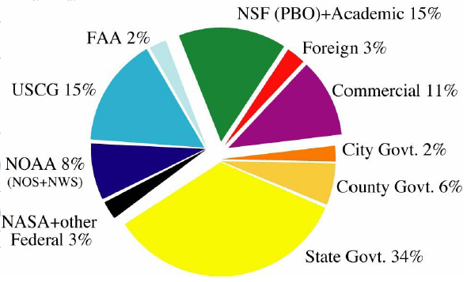
U.S. Continuously Operating Reference Stations (CORS)
US-wide GPS network
Coordinated by National Geodetic Survey at NOAA
Maintain archive
Check position coordinates daily
Update official coordinates in case of significant displacements
Cooperative network: govt, academic, commercial, etc.
Purpose: provide GPS data to civil users; positioning capability of few cm
Surveyors
GIS professionals
Air traffic
Engineers, scientists
Courtesy F. Nievinski, University of Colorado

Slide 37
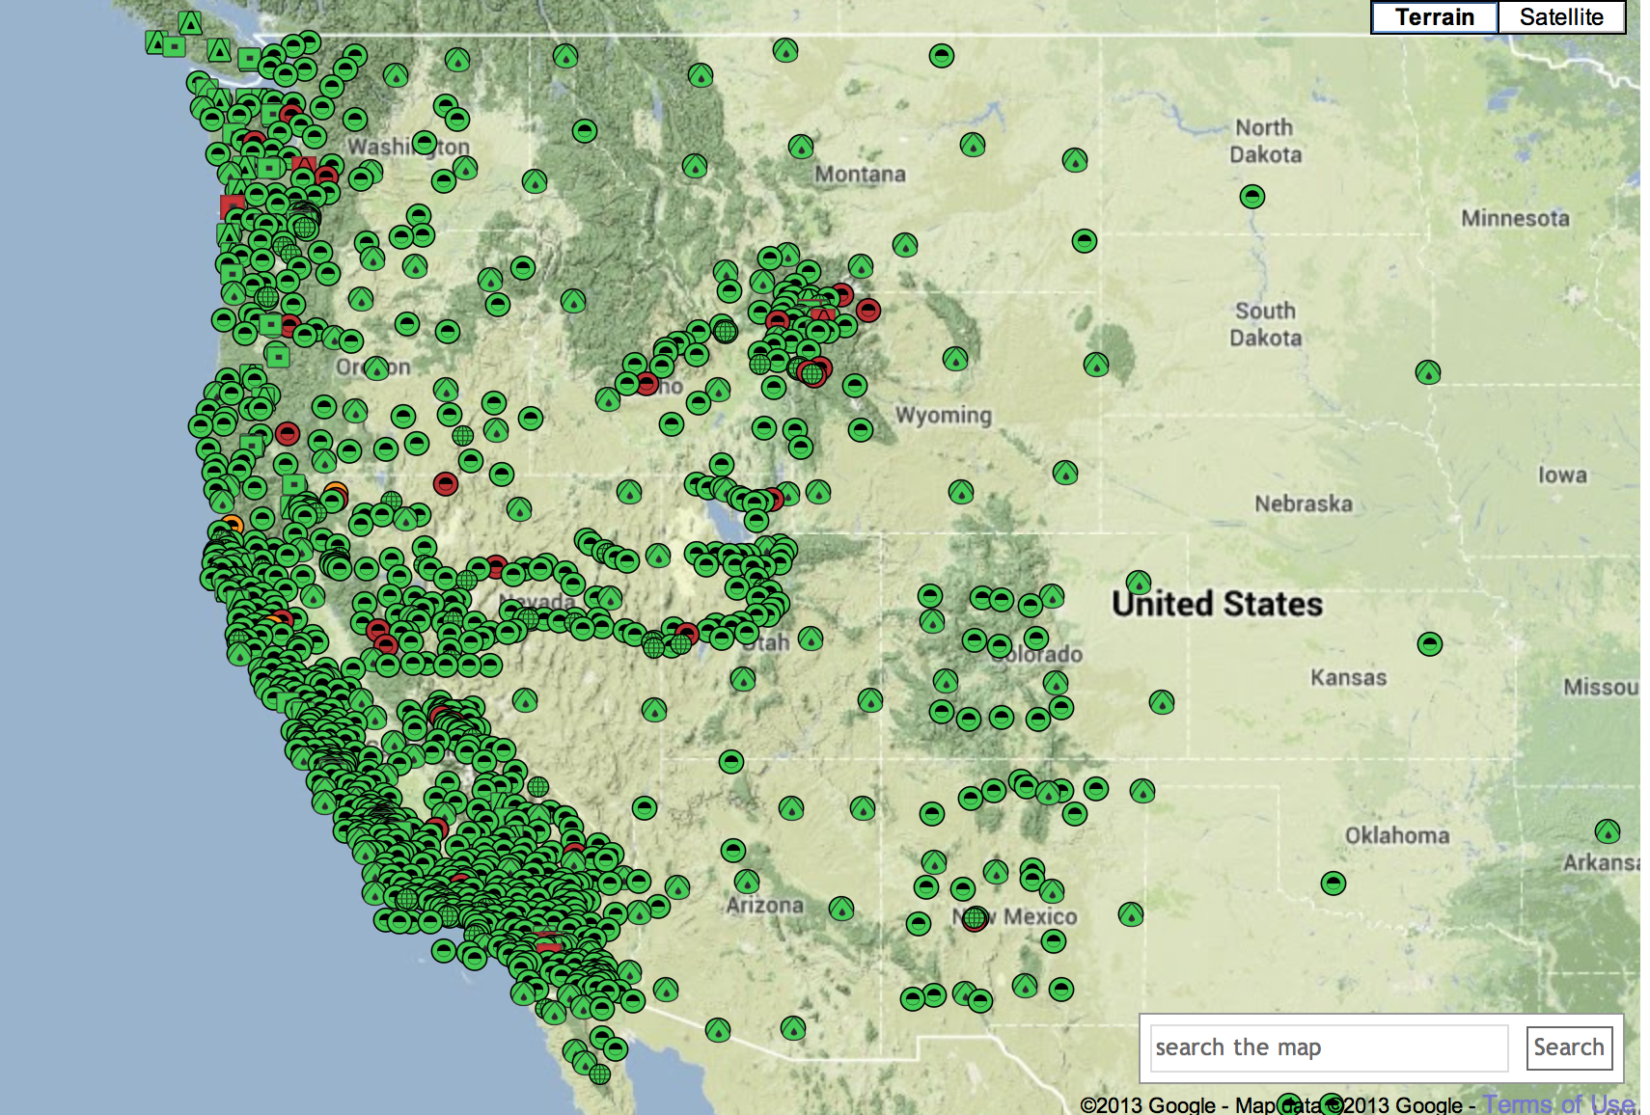
Lots and Lots of Networks. pbo.unavco.org
Courtesy F. Nievinski, University of Colorado

Slide 38
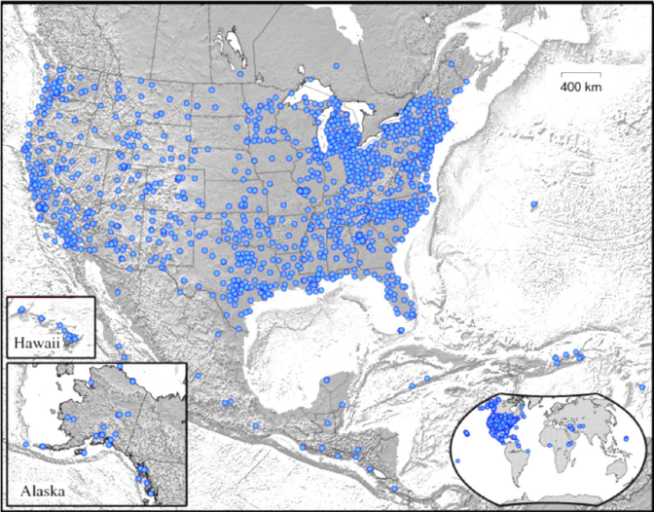
CORS Network
But almost none of these sites belong to NGS-NOAA. NGS is a “regifter.”
38

Slide 39
Take home message on precise positioning
Use of carrier phase data has enabled far more precise applications of GPS than basic code-based positioning
Modernized signals and global networks are making it easier to exploit carrier phase without investing in local RTK systems and software

